Slide 1

Security+
Exam SY0-601
Chapter 12
Authentication and Authorization
Notes:
Gain Attention

Slide 2
Chapter 12 (Domain 2.4) Learning Objectives
Summarize authentication and authorization design concepts.
Authentication methods
Directory services
Federation
Attestation
Technologies
Time-based on-password (TOTP)
HMAC-based one-time password (HOTP)
Short message service (SMS)
Token key
Statice codes
Authentication applications
Push notifications
Phone call
Smart card authentication
Biometrics
Fingerprint
Retina
Iris
Facial
Voice
Vein
Gait analysis
Efficacy rates
False acceptance
False rejection
Crossover error rate
Multifactor authentication (MFA) attributes
Factors
Something you know
Something you have
Something you are
Attributes
Somewhere you are
Something you can doo
Something you exhibit
Someone you know
Authentication, authorization, and accounting (AAA)
Cloud vs on-premises requirements

Slide 3
Authentication Methods
Authentication is the process of verifying an identity previously established in a computer system.
There are a variety of methods of performing this function, each with its advantages and disadvantages, as detailed in the following sections.

Slide 4
Directory Services
A directory is a data storage mechanism similar to a database, but it has several distinct differences designed to provide efficient data-retrieval services compared to standard database mechanisms.
A directory is designed and optimized for reading data, offering very fast search and retrieval operations.
The types of information stored in a directory tend to be descriptive attribute data.
The data is hierarchically described in a treelike structure, and a network interface for reading is typical.
Common uses of directories include e-mail address lists, domain server data, and resource maps of network resources.
Lightweight Directory Access Protocol (LDAP) is commonly used to handle user authentication and authorization and to control access to Active Directory (AD) objects.

Slide 5
Directory Services
X.500 was created as a standard for directory services.
LDAP can interface with X.500 services and, most importantly, can be used over TCP with significantly fewer computing resources than a full X.500 implementation.
LDAP offers all of the functionality most directories need and is easier and more economical to implement; hence, LDAP has become the Internet standard for directory services.
A client starts an LDAP session by connecting to an LDAP server, called a Directory System Agent (DSA), which is by default on TCP and UDP port 389 or on port 636 for LDAPS (LDAP over SSL).

Slide 6
Federation
Federation, or identity federation, defines policies, protocols, and practices to manage identities across systems and organizations.
Federation’s ultimate goal is to allow users to seamlessly access data or systems across domains.
Federation is enabled through the use of industry standards such as Security Assertion Markup Language (SAML), discussed in Chapter 24, “Implement Authentication and Authorization.”
Federated identity access management systems allow users to authenticate and access resources across multiple enterprises using a single credential.
Don’t confuse this with single sign-on (SSO), which allows users access to multiple resources within a single organization or enterprise.

Slide 7
Attestation
Attestation is the supplying of proof or evidence of some fact.
In the case of authentication, attestation can be done by a service that checks the credentials supplied, and if they are correct and match the required values, the service can attest that the entry is valid or correct.
Attestation is used throughout cybersecurity whenever a third party or entity verifies an object as valid, or an item as correct in value.

Slide 8
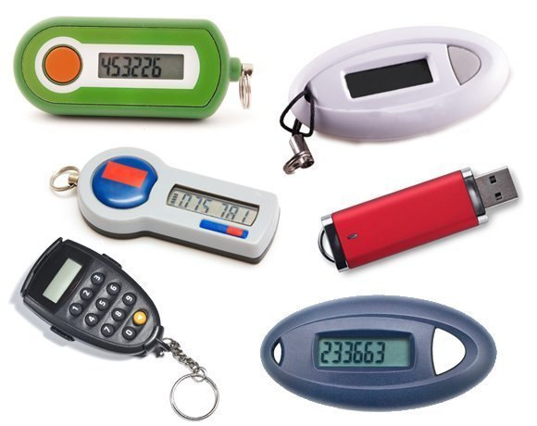
Technologies
There are multiple ways to perform authentication, and multiple technologies can be employed to assist in the effort.
Time-based One-Time Password (TOTP)
HMAC-based One-Time Password (HOTP)
Short Message Service (SMS)
Token Key
Static Codes
Authentication Applications
Push Notifications
Phone Call

Slide 9
Smart Card Authentication
A smart card (also known as an integrated circuit card [ICC] or chip card) is a credit card–sized card with embedded integrated circuits that is used to provide identification security authentication.
Smart cards can increase physical security because they can carry long cryptographic tokens that are too long to remember and too large a space to guess.
Smart cards can be used in a variety of situations where you want to combine something you know (a PIN or password) with something you have (and can’t be duplicated, such as a smart card).
Aka Personal Identification Verification (PIV) card

Slide 10
Biometrics
Biometric factors are measurements of certain biological factors to identify one specific person from others.
These factors are based on parts of the human body that are unique.
Fingerprint
Retina
Iris
Facial
Voice recognition
(not speech recognition)
Vein (Palm scan)
Gait

Slide 11
Biometrics
Biometric measurements have a level of uncertainty, and thus the efficacy of biometric solutions has been an issue since they were first developed.
For biometrics to be effective, they must have both low false positive rates and low false negative rates.
The terms false acceptance rate (FAR) and false rejection rate (FRR) describe the chance that an incorrect user will be falsely accepted, or a correct user will be falsely rejected.

Slide 12
False Acceptance
The false acceptance rate (FAR) determines what level of false positives is allowed in the system.
A false acceptance (or false positive) is demonstrated by the grayed-out area in Figure 12-3. In this area, the two curves overlap, and the decision has been made that at this threshold (or better) an accept signal will be given.
Thus, if you are not a match, but your measured value falls on the upper end of the nonmatch curve (in the gray area), you will be considered a match, and hence become a false positive.
The false acceptance rate is expressed as the probability that the system incorrectly identified a match between the biometric input and the stored template value.

Slide 13
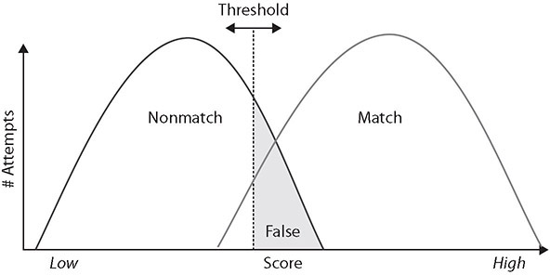
False Acceptance

Slide 14
False Rejection
The false rejection rate (FRR) determines what level of false negatives, or rejections, are going to be allowed in the system.
A false rejection is demonstrated by the grayed-out area in Figure 12-4.
In this section, the curves overlap, and the decision has been made that at this threshold (or lower), a reject signal will be given.
Thus, if you are on the lower end of the match curve (in the gray area), you will be rejected, even if you should be a match.
The false rejection rate is expressed as the probability that the system incorrectly rejected a legitimate match between the biometric input and the stored template value.

Slide 15
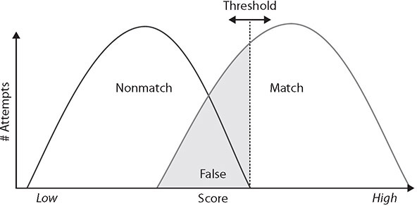
False Rejection

Slide 16
Crossover Error Rate
The crossover error rate (CER) is where both accept and reject error rates are equal.
This is the desired state for the most efficient operation, and it can be managed by manipulating the threshold value used for matching.
In practice, the values may not be exactly the same, but they will typically be close to each other.
Figure 12-5 demonstrates the relationship between the FAR, FRR, and CER.

Slide 17
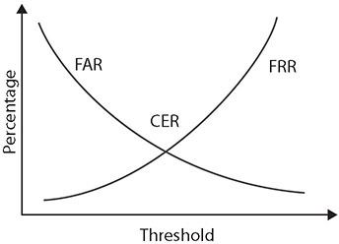
Crossover Error Rate

Slide 18
Multifactor Authentication (MFA) Factors and Attributes
Multifactor authentication (or multiple-factor authentication) is simply the combination of two or more types of authentication.
What You Know (Type 1)
What You Have (Type 2)
What You Are (Type 3)
Something You Do
Somewhere You Are
Two-factor authentication (TFA) combines any two of these before granting access.
Multifactor authentication (MFA) methods greatly enhance security by making it very difficult for an attacker to obtain all the correct materials for authentication.

Slide 19
Something You Know
Username
Email address
Passwords
PINs
Codes
Security Questions
Physical address
Phone number

Slide 20
Something You Have
Smart cards/PIV cards
Security tokens
Badges
Smartphones
OTP generators

Slide 21
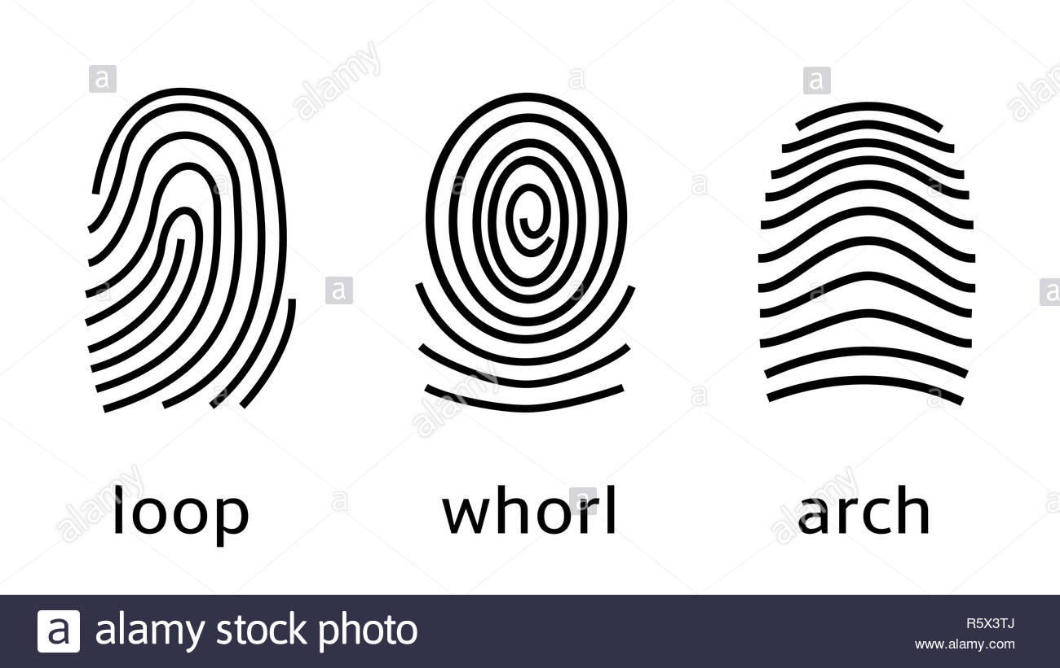
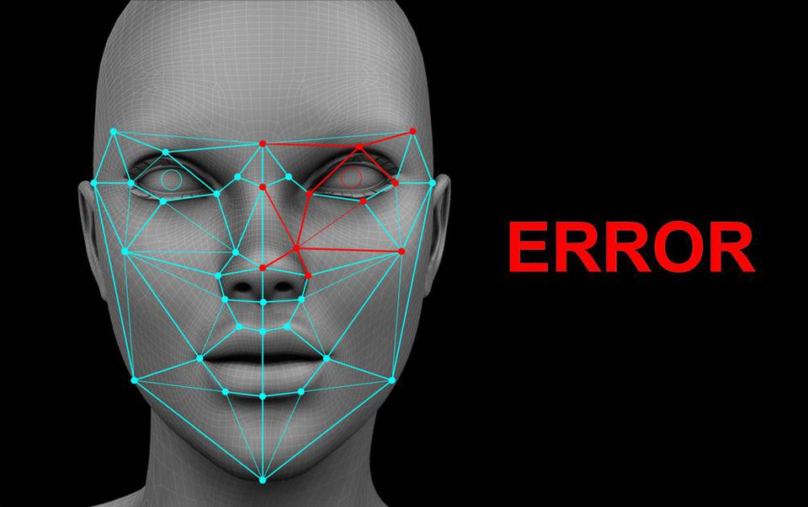
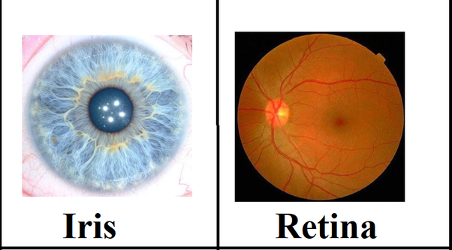
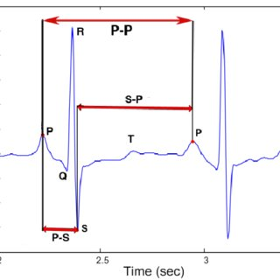
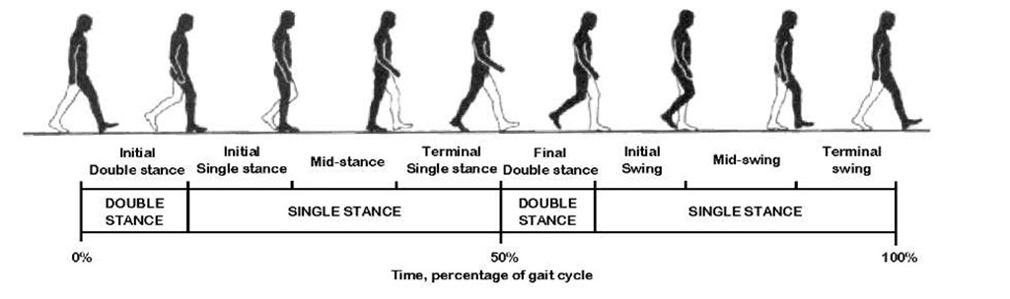
Something You Are
Fingerprints
loops, arches, and whorls
Palm scans
Palm geometry
Veins
Facial recognition
Retina scan
Infrared light
Iris scan
Ultraviolet light
Gait biometrics
Walking
Heartbeat biometrics

Slide 22
Attributes
Attributes are collections of artifacts, like the factors previously presented, but rather than focus on the authentication item, they focus on elements associated with the user.
Common attributes include the user’s location, their ability to perform a task, or something about the user themselves.
These attributes are discussed in the following sections.

Slide 23
Somewhere You Are
One of the more discriminant authentication factors is your location, or somewhere you are.
When a mobile device is used, GPS can identify where the device is currently located.
When you are logged on to a local, wired desktop connection, it shows you are in the building.
Both of these can be compared to records to see if you are really there or should be there.
If you are badged into your building, and at your desk on a wired PC, then a second connection with a different location would be suspect, as you can only be in one place at a time.

Slide 24
Something You Can Do
Something you can do specifically refers to a physical action that you perform uniquely.
An example of this is a signature; the movement of the pen and the two-dimensional output are difficult for others to reproduce.
This makes it useful for authentication, but challenges exist in capturing the data, as signature pads are not common peripherals on machines.
Gait analysis, presented earlier, is another example of this attribute.
Something you can do is one of the harder artifacts to capture without specialized hardware, making it less ubiquitous as a method of authentication.
Keystroke dynamics

Slide 25
Something You Exhibit
Something you exhibit is a special case of a biometric.
An example would be a brainwave response to seeing a picture.
Another example would be the results of a lie detector test.
The concept is to present a trigger and measure a response that cannot be faked.
As sensors improve, tracking eye movement and sensing other aspects of responses will become forms that can be used to assist in authentication.

Slide 26
Someone You Know
Someone you know relates to a specific memory, but in this case an individual.
This is the classic “having someone vouch for you” attribute.
Electronically, this can be done via a chain of trust model, and it was commonly used in the past as a result of people signing each other’s keys, indicating trust.

Slide 27
Authentication, Authorization, and Accounting (AAA)
Authentication is the process of verifying an identity previously established in a computer system.
Authorization is the process of permitting or denying access to a specific resource.
Accounting is the process of ascribing resource usage by account for the purpose of tracking resource utilization.
Together, they make up the AAA framework for identity access security.

Slide 28
Cloud vs. On-premises Requirements
Authentication to cloud versus on-premises requirements is basically a revisiting of the identity and authentication problem all over again.
When establishing either a cloud or on-premises system, you use identity and authentication as the foundation of your security effort.
Active Directory
Federated Identity Management (FIM)
SAML
OpenID
OAuth

